Slide 1

Amazon Sales Analysis
Name : Essam Alaa
Cairo University
Faculty Of computer and Artificial Intelligence
Data Science Dept

Slide 2

Exploratory Data Analysis
From The initial Inspection of the data, We concluded That the data is For Amazon sales in India, and it is from March to June year 2022
The Data Contains 24 Features and 128975 examples
The data has no duplicates
Numerical Features ‘Amount’ and ‘Qty’ need to be scaled as their range of values is different from each other
Presence Of categorical Features which need to be encoded
Some Categorical Features Such as ‘currency’ ‘ship-country’ ‘fulfilled-by’ and ‘Unnamed:22’ contains only 1 variable so they are not adding any information

Slide 3
Exploratory Data Analysis
The data contains many null values across the different Features
Date column should be datetime not object
columns [ship-country , ship-city , ship-state , ship-postal-code] are considered as hierarchical features starting from country to postal-code , so we can keep the column with the lowest granularity which is postal code and drop the others
column 'fulfilled-by' has 89698 null values which means that approximately 69.5% of the column is missing , so this column will be dropped as imputing it will be misleading , and also it contains only one variable
columns 'promotion-ids' has null values 49153 which will be dropped also due to large number of missing values

Slide 4
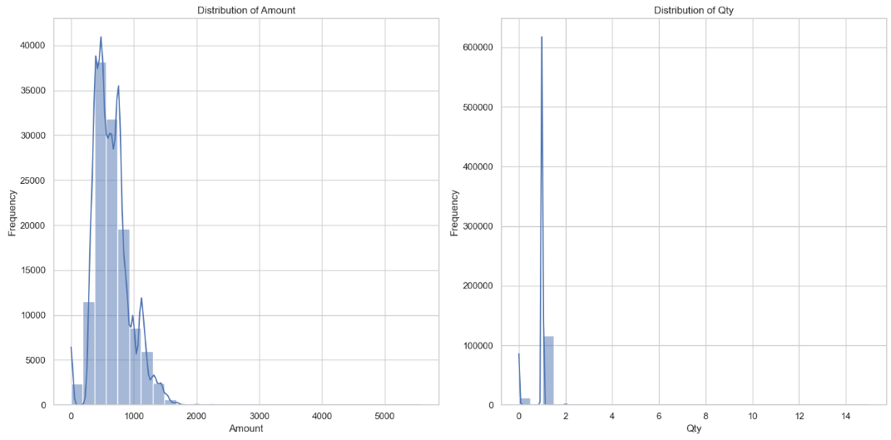
Data Visualization
From this Graph the need of Scaling the Two feature is clear

Slide 5
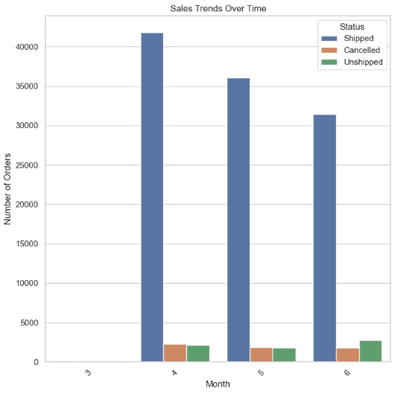
Data Visualization
This graph Shows that Top Month in Sales is April which is True But it Shows that March is the lowest one which is misleading since the data collected from march is too small compared to the other Months, so it is expected to see March that low

Slide 6
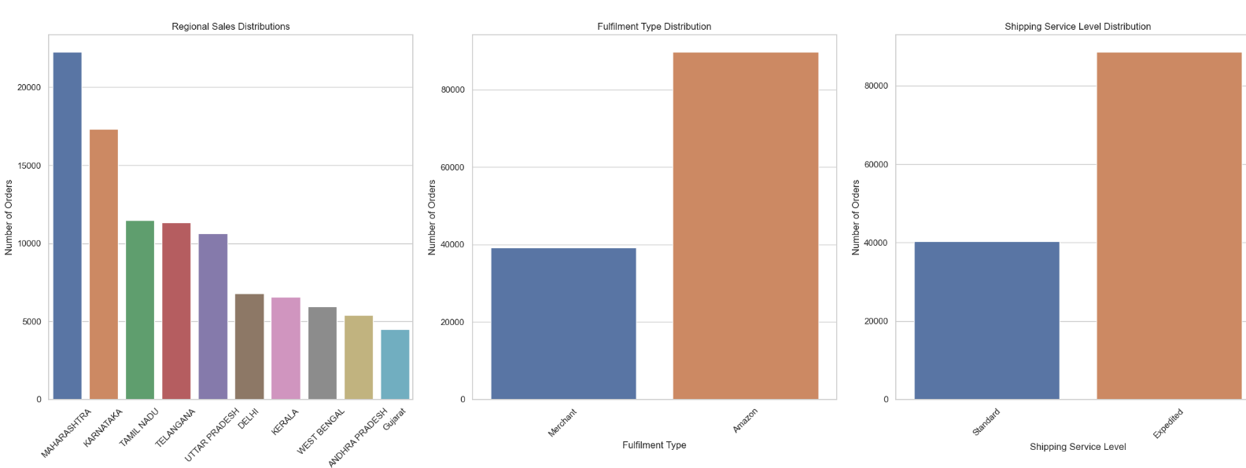
Data Visualization
The Figure Shows how the Features value are distributed in column Fulfilment and Shipping service level
It also shows the top 10 states in sales

Slide 7
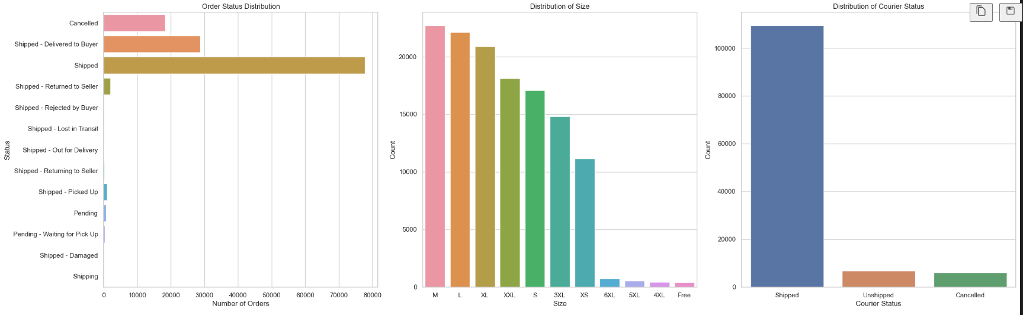
Data Visualization
The graph here shows the distribution values for column Size , Status and courier status
It also showed us that we will need to use resampling Techniques in modeling phase due to the imbalanced target variable courier status

Slide 8
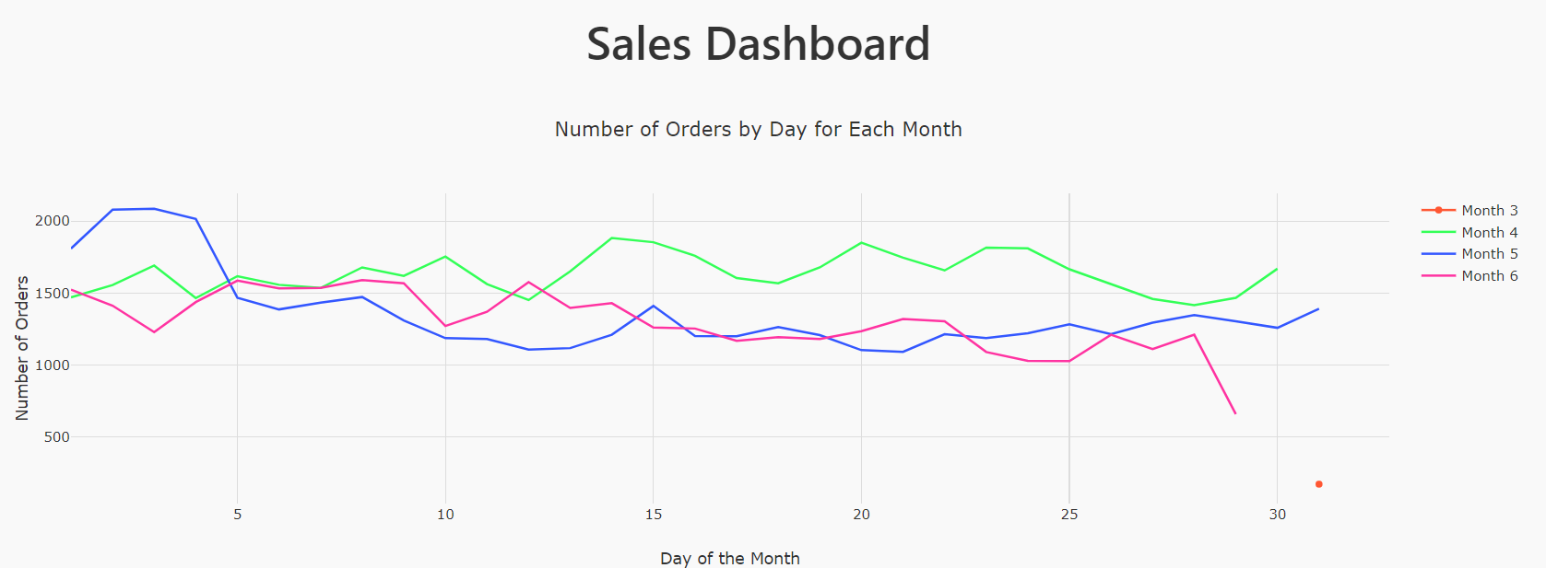
Dashboard For sales
The following Graph Shows The Sales trend in Each Month across all days
It also shows that the data collected for march is on day 31 only which justify why it has too low sales compared to the others

Slide 9
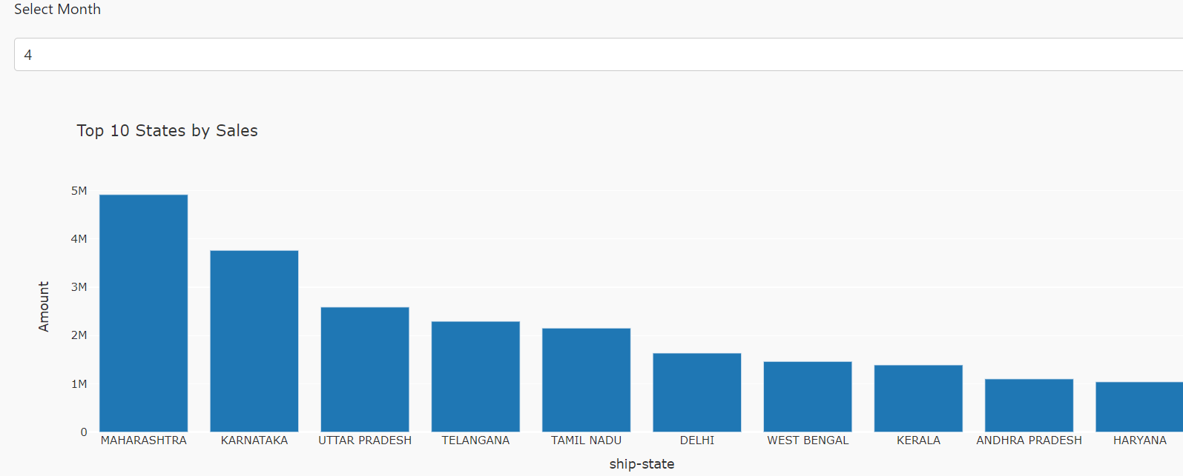
Dashboard For sales
The following shows top 10 sales city and State in specific month (Its interactive as you can select the month from the drop down menu and it will display it)

Slide 10
Data Preprocessing
First , Columns 'currency','ship-country','fulfilled-by','Unnamed: 22’ will be dropped as they only contain one value
Columns 'ship-city', 'ship-state’ will be dropped and we will keep ‘ship-postal-code’ as the 3 columns refers to the same thing but with different hierarchies
Columns ‘index’ ‘order-id’ will be dropped as they are key columns
Column data will be converted to datetime then we will extract Day , Month and Year from it then make a separate column for each
Then we will drop column date as we don’t need it and column year will be dropped since it contain only one value which is 2022

Slide 11
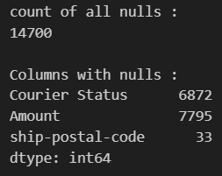
Data Preprocessing
The below Image shows the null values across different feature
Column Courier Status will be imputed using "probabilistic imputation" or "stochastic imputation.“
Column Amount will be imputed Using Knn Imputer
Column ship-postal-code null values rows will be dropped

Slide 12
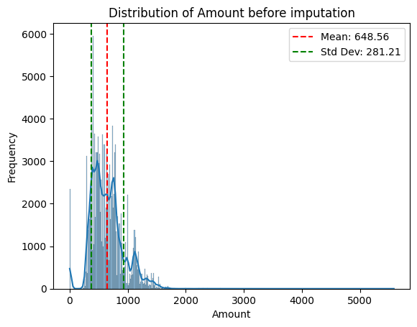
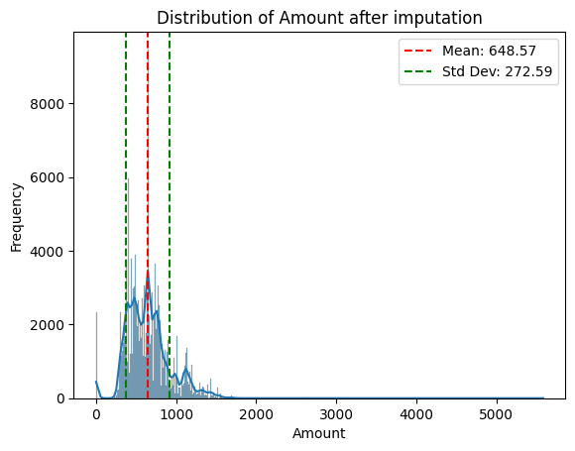
Data Preprocessing
Column Amount will be imputed Using Knn Imputer
The 2 Graphs shows The distribution of column amount before and after imputation which is clear that the distribution of the column is almost preserved

Slide 13
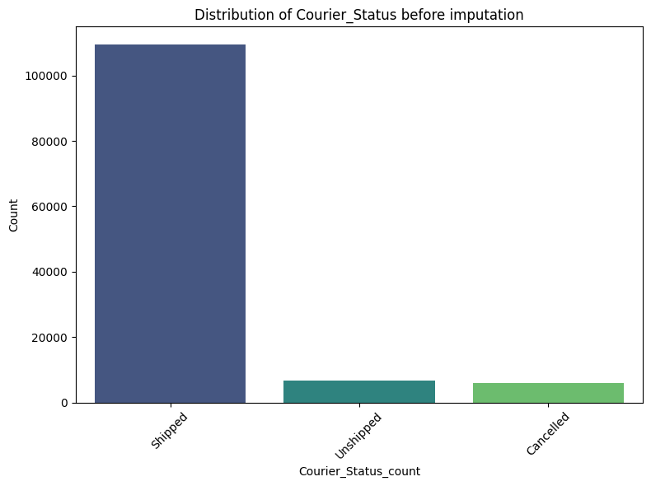

Data Preprocessing
Column Courier-status null values will be imputed using "probabilistic imputation" or "stochastic imputation.“
Here is the distribution before and after the imputation

Slide 14
Data Preprocessing
All Categorical Variables will be encoded Using label encoder
After all categorical data encoded , all data will be scaled using standard scaler even the encoded categorical data to ensure that all data will be within the same scale
Only courier status column will not be scaled as it is the target column

Slide 15
Feature Selection
We have used Forward Feature Selection on our data and its output was:
Selected features:('Status', 'Fulfilment', 'Sales Channel ', 'Style', 'SKU', 'Category', 'ASIN', 'Qty', 'Amount', 'ship-postal-code', 'B2B', 'Month', 'Day’)
Accuracy of the selected feature subset: 0.9920894326257302
Final accuracy on test set: 0.9915208231005869

Slide 16
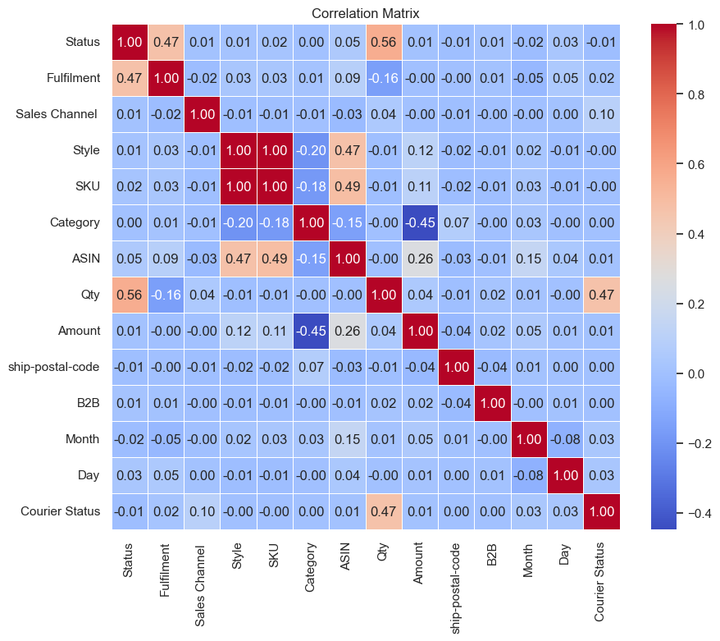
Feature Selection
According to the following correlation matrix
Sku and style are nearly identical so one of them will be dropped

Slide 17
Outlier Detection
We are going to use clustering to identify outliers but first we will calculate the Hopkins statistic to see how well the data rends to be in clusters then we will use the elbow method to identify the number of clusters

Slide 18
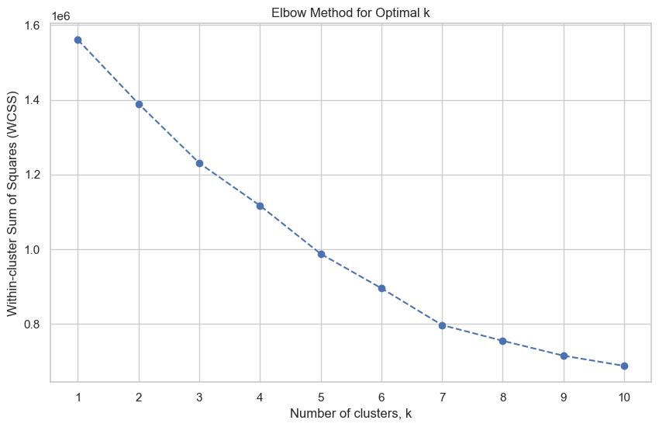
Outlier Detection
The Hopkins statistic is 0.891619922810035 which shows that the data has a good tend to be clustered
The above graph for elbow method shows the number of k to be 6

Slide 19
Outlier Detection
The outliers are 4620 rows which will be deleted to make the classification process more robust

Slide 20
Modeling
Since we have an imbalanced target variable so we will use SMOTE Which is a resampling technique especially its an upgrade for the oversampling method
Then we will use Logistic regression to classify the data points
Our performance metrics will be
Confusion matrix
Precision
Recall
F1-score
Then we will use Cross validation to ensure the stability of the training process over the different folds

Slide 21
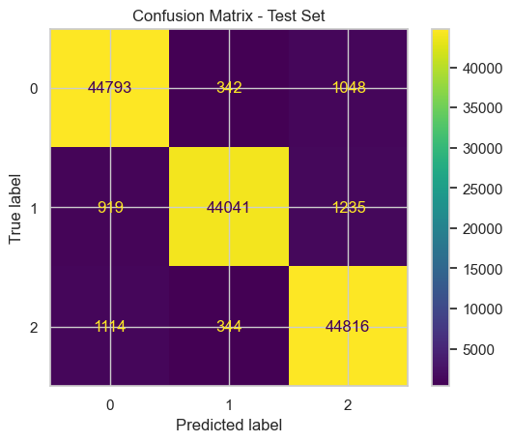

Modeling
Precision (Test): 0.9643 Recall (Test): 0.9639 F1-score (Test): 0.9640
Precision (Train): 0.9638 Recall (Train): 0.9634 F1-score (Train): 0.9635

Slide 22
Modeling
From the above result we conclude that The logistic regression model exhibits high precision, recall, and F1-score on both the training and test datasets, indicating excellent performance and minimal overfitting. The close alignment of performance metrics between the training and test sets further confirms the model's generalization capability.
We also computed the train and test loss to ensure there is no overfitting and the results are
Test Log Loss: 0.0672751293752297
Train Log Loss: 0.06816430072421226
The Loss difference is too low between train and test so there is no overfitting

Slide 23
Modeling
The Results of the cross-validation method is as follow
Cross-Validation Results:
Fold 1: Accuracy : 0.9636 Precision : 0.9639 Recall : 0.9636 F1-score : 0.9636
Fold 2: Accuracy : 0.9632 Precision : 0.9635 Recall : 0.9632 F1-score : 0.9633
Fold 3: Accuracy : 0.9641 Precision : 0.9644 Recall : 0.9641 F1-score : 0.9641
Fold 4: Accuracy : 0.9633 Precision : 0.9638 Recall : 0.9633 F1-score : 0.9634
Fold 5: Accuracy : 0.9631 Precision : 0.9635 Recall : 0.9631 F1-score : 0.9631
Mean Scores: Accuracy : 0.9634 Precision : 0.9638 Recall : 0.9634 F1-score : 0.9635
From the 5 folds we concluded that the stability of the training process across different folds

Slide 24
END

